Slide 1

College recruitment workshop
October 14, 2022

Slide 2
Agenda
How to communicate with college coaches
How to show off your assets
Knowing the NCAA recruiting rules and tips on navigating the recruitment process
  NCAA Eligibility Center Registration
  Recruiting Visits
  Important Recruiting Rules
  Scholarships
Alternative Recruiting Methods
Helpful Resources

Slide 3
How to communicate
With college coaches

Slide 4
Tips for Reaching Out
BE PROACTIVE! Most high school athletes must initiate contact
BE PREPARED! Before reaching out to coaches, prepare a resume, cover letter (used in the body of your email) and if possible, a highlight video.
BE ACCURATE! Obtain coaches’ contact information from college athletics website or contact the athletics department directly.
BE SPECIFIC! When drafting emails to coaches, keep them brief and to the point but make sure they include everything the coach needs to become interested in you.

Slide 5
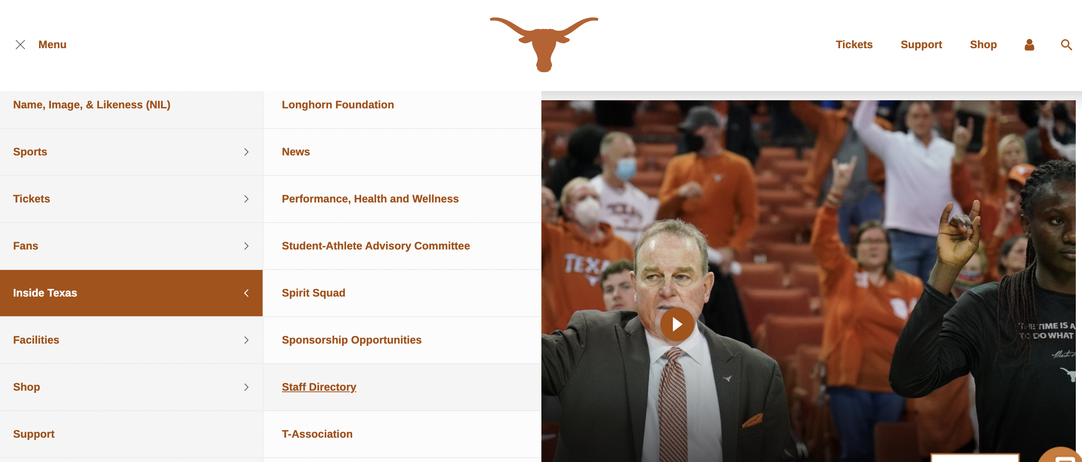

Slide 6
Who should I email?
Head Coach
Assistant coaches – specifically if one of the assistant coaches oversees a specialized position which is also your position (i.e., goalie coach in soccer)
Anyone labeled a “recruiting coordinator”
Compliance Officer

Slide 7
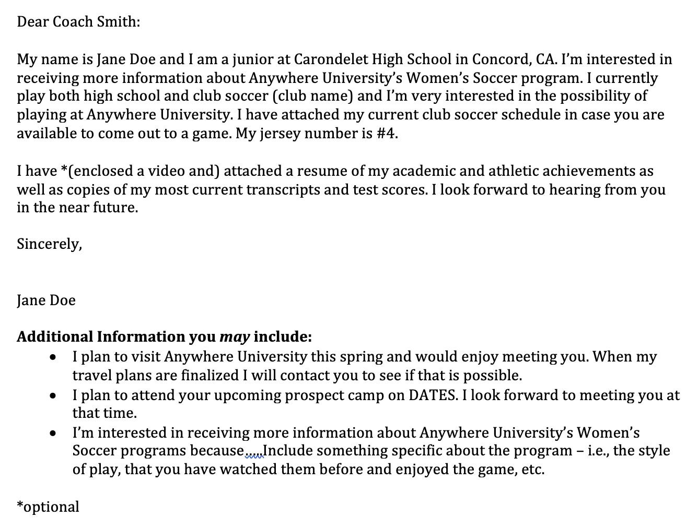

Slide 8
Tips for Correspondence….
Make sure you use the correct name/university name
Make sure to use the correct coaches’ names
Include something personal about the sports program and/or university
Don’t make it too long – catch their interest and then include a more-thorough attachment (resume)
Make sure to attach the following:
  Resume
  Transcripts/test scores (unofficial is fine)
  Game Schedules
  Videos (if available)

Slide 9
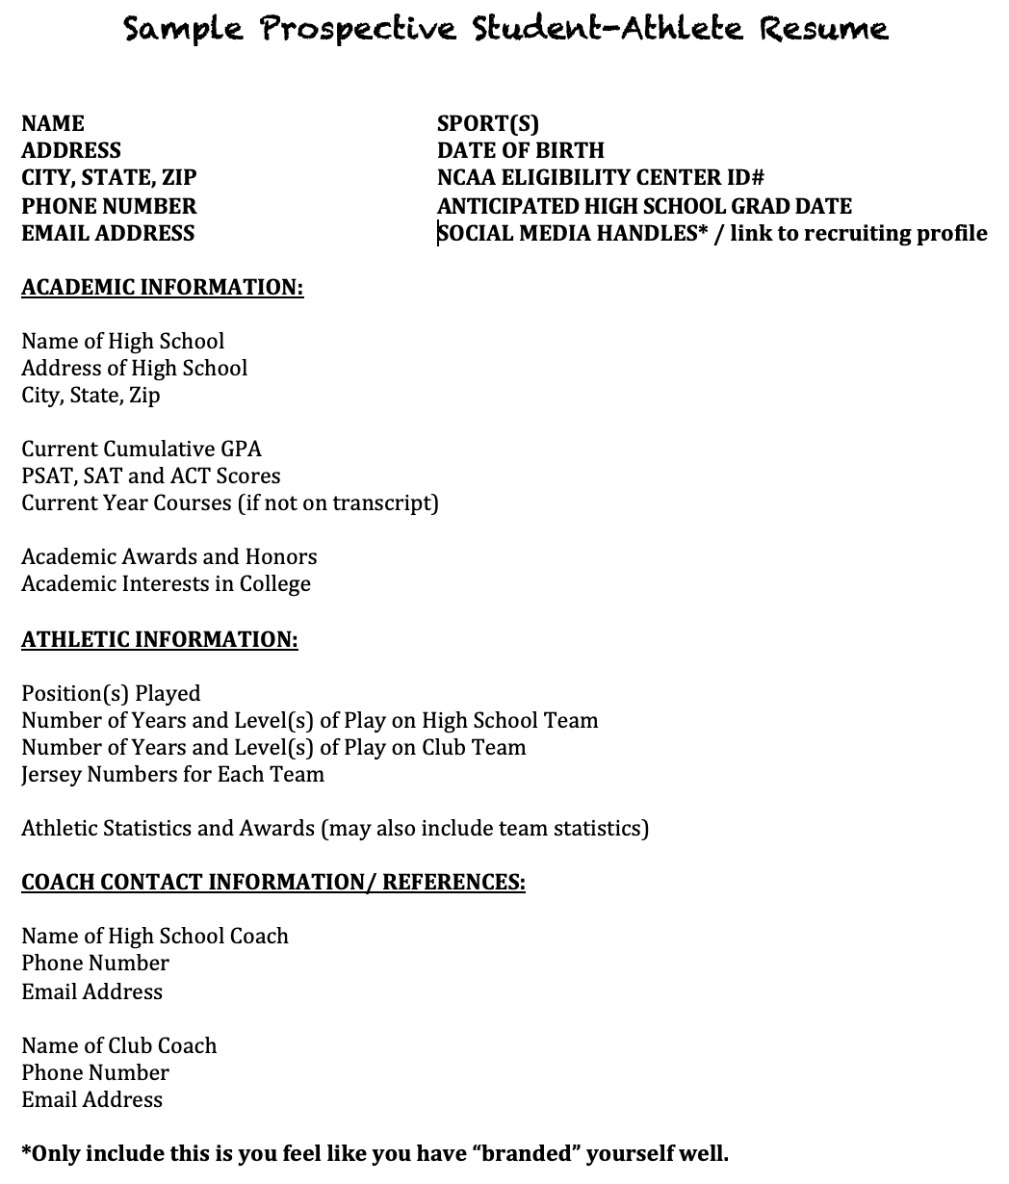

Slide 10
Social Media Tips
Coaches will likely find your social media account regardless of whether you include it on your athletics resume
Make sure it is CLEAN
However, you also want your personality to shine through so use your page to do this! Coaches are recruiting you for EVERYTHING you can offer to the team, not just your athletic accomplishments.
NIL & Fan Favorite potential

Slide 11
Questions to Ask Coaches
How many new players are you looking for? What is the roster size?
What position(s) do you see me playing in? Are you recruiting for my position? How many students are you recruiting for my position?
How many scholarships do you have available? What are terms for keeping a scholarship? Are there opportunities to walk-on?
What is the average GPA of the team? What academic support is provided to the student-athletes?
What are the practice demands/expectations during the year? How heavy is the travel schedule – how often will I miss class?
How is the program funded (i.e., Are meals provided during the season? How much equipment is provided? How often is it updated/maintained? Does an athletic trainer travel with the team?)
How much flexibility does admissions allow for prospects in meeting academic admissions requirements?

Slide 12
WHEN to Contact: NCAA Telephone Calls, Emails, Text Messages (correspondence)
DI – rules vary by sport – most ”start dates” occur between sophomore and junior year
DII – everything is June 15 immediately preceding Junior year
DIII – unlimited with the exception of off-campus contacts which can occur following Sophomore year
*There are exceptions for questionnaires, camp brochures and non-athletics information

Slide 13
What does this mean?
Send the email….BUT don’t expect a response.
Have your high school or club coach call but don’t try to join the call (this is a “no no”)
EVALUATIONS are always permitted so send your team name(s), schedule(s) and jersey number(s).
You can still do your research on the school, watch games, visit schools…

Slide 14
When to Contact: NAIA Recruiting
NAIA recruiting rules encourage coach-student and personal relationships. Benefits of NAIA recruiting rules include:
No recruiting calendar restrictions of any kind
Ability to freely communicate with NAIA coaches directly
Direct interaction with NAIA coaches
What does this mean? START EARLY!

Slide 15
Showing off your assets
What to do after the first contact…

Slide 16
Tips for Putting Your Best Foot Forward
Research colleges before reaching out to coaches. Look for specific sport and division of play (The NCAA is organized into 3 divisions.) What is offered by the college in regards to academics, location, size, student environment, selectivity, etc.? Is this a college you would be happy at IF you didn’t play soccer?
Meet with your current club or high school coach and ask them what your level of ability is. Be realistic! Use this conversation when drafting your prospective student-athlete resume and developing a list of colleges to contact.
Complete an online questionnaire on the college’s athletics website or when sent by a coach.
Ask your club or high school coach to provide a recommendation.

Slide 17
NCAA divisions all vary
Big differences include athletic scholarships, time demands and budgets.

Slide 18
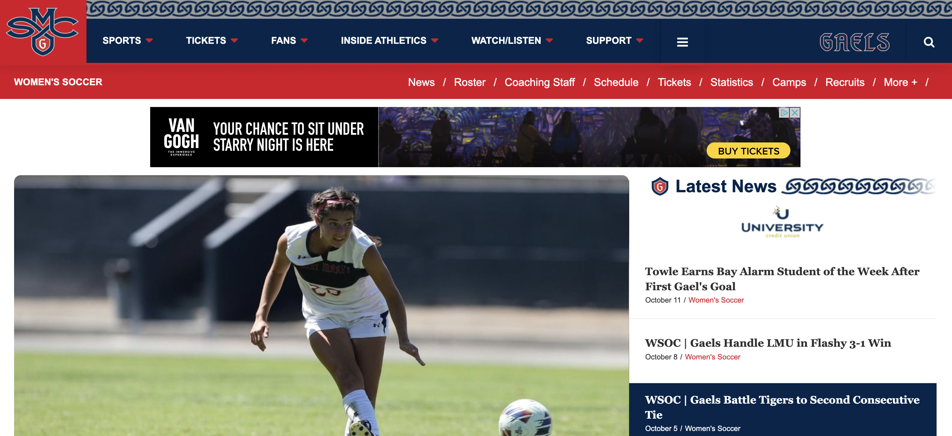

Slide 19
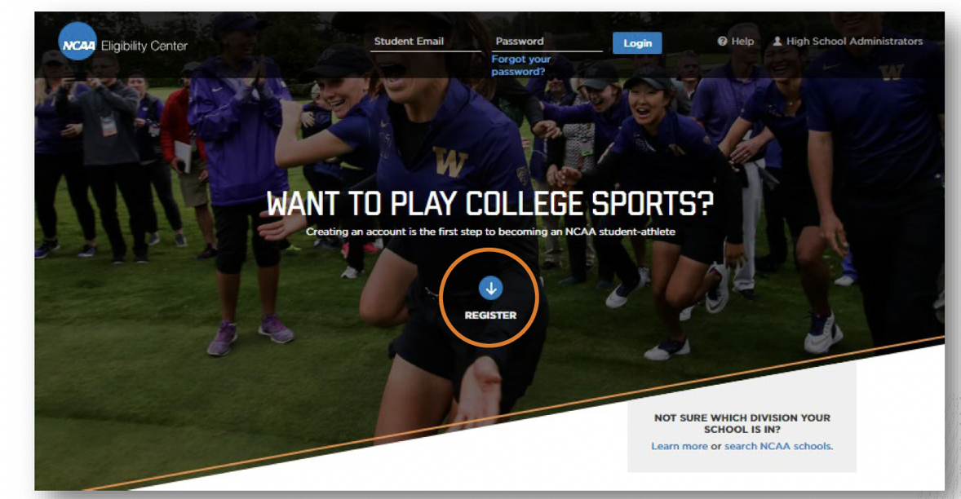
NCAA Eligibility Center

Slide 20
NCAA Eligibility Center: Account Types
Free Profile Account
Certification Account
Used for young recruits and those undecided on division
No registration fee
Ability to transition to a paid certification account later on
Required for DI and DII eligibility certification
Requires a registration fee:
  $90 domestic students
  $150 international students
Required for taking an official visit
Required to sign a NLI
Amateurism Only Account
Used for DIII schools (amateurism only)

Slide 21
NCAA Eligibility Center
WHEN do I register?
  9th grade – register for Free Profile Page
  10th grade – transition to Certification Account
WHY do I register?
  Required for taking an official visit
  Coaches can track your progress/ see your grades
  Helps colleges/universities determine your scholarships
  Compliance can track your eligibility progression
  Required to sign a National Letter of Intent

Slide 22
NCAA Amateurism Requirements
Must complete the Amateurism questionnaire for EACH sport you plan to compete in and request “Final Amateurism Certification” on April 1 (for Fall enrollees).
Issues Reviewed as Part of the Amateurism Certification Process:
  Delaying your full-time collegiate enrollment to participate in organized competition.
  Playing with professionals.
  Signing a contract with a professional team.
  Participating in tryouts or practices with a professional team.
  Receiving payment or preferential treatment/benefits for playing sports.
  Receiving prize money.
  Receiving benefits from an agent or prospective agent.
  Involvement with a recruiting service.

Slide 23
NAIA Amateurism Requirements
In the NAIA, only amateur students-athletes are eligible to participate in a given sport.
If you become a professional in a particular sport recognized by the NAIA, you will be considered a professional in that sport only and are ineligible for intercollegiate competition in that sport.
The following will cause a student to lose amateur standing:
  Signing a contract with any professional team or entering into an agreement to compete in professional athletics
  Participating in any athletics contest as a professional or as a team member where you receive reimbursement exceeding the actual expenses of travel, meals and lodging
  Receiving remuneration for any appearance or advertisement/promotion that references the student’s collegiate institution or intercollegiate athletic participation.

Slide 24
Prepping for campus visits
What should I know before I go!

Slide 25
Why Campus Visits are Important!
You can FEEL what its like to be on campus – think about time of the year you visit!
The team AND coach get to know the REAL YOU!
You get a better feel for TEAM CULTURE.
You get to know other members of the Athletics Department (academic support, athletic trainers).

Slide 26
Recruiting 101: Campus Visits
Types?
  Official Visits – College can pay for transportation to and from the campus and lodging and meals and reasonable entertainment for a 48 hour period. Basketball also allows for payment for up to two family members on the visit.
  Unofficial Visits – Self funded visits
How Many?
When?
  No visits allows during Recruiting Shutdown and Dead Period
  DI - Official visits begin Junior year (dates vary)
  DII – June 15 prior to junior year
  DIII – January 1 of junior year
DI OV | DII OV | DIII OV | NAIA OV
5 per athlete 1 per institution Certain sports limit per sport *No limit on UV | No limit per athlete 1 per institution *No limit on UV | No limit per athlete 1 per institution *No limit on UV | No limit per athlete 1 per institution *No limit on UV

Slide 27
Tips for Unofficial Visits
Planned vs Unplanned Visits – don’t just show up unannounced & check the recruiting calendars!
Coaches are permitted to provide you with up a limited number of complimentary admissions to their home games!
Set up an appointment with the coach ahead of time. All coaches must abide by an NCAA recruiting calendar and are not permitted to have in-person contact with prospects certain times of the year. Plan ahead!
Schedule an Admissions tour in addition to meeting with the coach. This will allow you to find out what majors are offered and how rigorous the courses will be.
Arrange a meeting or informational session with the Admissions and/or Financial Aid office – clarify any issues about how applications are handled and confirm a timeline for applications. Ask about academic requirements for admissions and FAFSA requirements for financial aid.

Slide 28
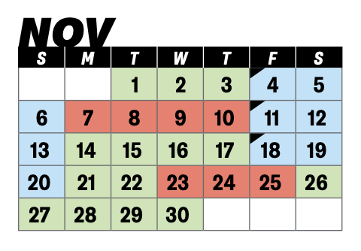

Recruiting 101: Recruiting Calendars
NCAA DI & DII Recruiting Calendars
NCAA DIII – no recruiting calendars
NAIA – no recruiting calendars

Slide 29
Recruiting 101: DI & DII Recruiting Periods Defined
Contact Period: Authorized athletics department staff may make in-person, off-campus recruiting contacts and evaluations.
Evaluation Period: Authorized athletics department staff members may be involved in off-campus activities designed to assess the academic qualifications and playing ability of prospective student-athletes. No in-person, off-campus recruiting contacts shall be made with the prospective student-athlete during an evaluation period.
Quiet Period: A period of time when it is permissible to make in-person recruiting contacts only on the member institution’s campus. No in-person, off-campus recruiting contacts or evaluations may be made during the quiet period.
Dead Period: A period of time when it is not permissible to make in-person recruiting contacts or evaluations on or off the member institution’s campus or to permit official or unofficial visits by prospective student-athletes to the institution’s campus.
Recruiting Shutdown: No form of recruiting is permitted (women’s basketball)

Slide 30
Tips for Official Visits
You will usually have a meeting with the Athletic Director, Compliance Officer and/or Head Coach so have your HARD QUESTIONS ready!
Get to know the team and ASK them questions!
Make sure to find out what its like to REALLY be a student-athlete at this school (e.g., dorm life, cafeteria, student support, campus size, study halls, athletic training room, weather, life outside athletics, etc.)
The program is trying to determine if you will be a GOOD FIT!

Slide 31
Official Visit Requirements:
Must be registered with the NCAA Eligibility Center
School must have a copy of your transcripts
Complete amateurism questionnaire on Eligibility Center
**Some colleges will check if you are admissible beforehand**

Slide 32
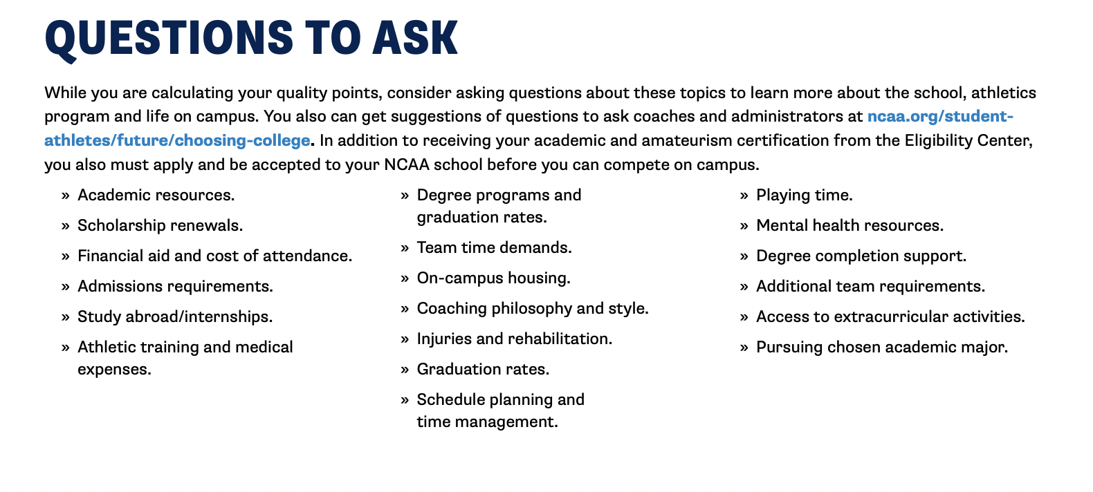
MORE….

Slide 33
Time to Talk Scholarships….
The visit is a great opportunity to bring up athletic scholarship availability.
Go into this talk knowledgeable about the cost to attend this university…
  E.g., if coach offers a $10,000 athletic scholarship, the overall cost of the college makes a HUGE difference.
  Talk to Financial Aid and Admissions about what other aid is available to you.
  Check out the Financial Aid/ Admissions websites for the college and look for the COST OF ATTENDANCE breakdown.
  Ask if this offer of aid is renewable? Is a multi year award available? Will the amount change (i.e., increase) in later years? What is your “out of pocket” expense? Is a book grant included?
    Know if your sport is a Head Count or Equivalency beforehand.
  This is usually the one time that coach will be fine with involving your parents.

Slide 34
Head Count vs Equivalency Sports
Head Count Sport – all athletes receiving an athletic scholarship are receiving a “full grant-in—aid” or “cost-of-attendance” scholarship
Indoor volleyball, basketball, tennis, gymnastics
Equivalency Sport – athletes receiving an athletic scholarship may receive any amount of athletic aid up to cost-of-attendance
Bowling, lacrosse, rowing, cross-country, track and field, skiing, fencing, soccer, field hockey, softball, golf, swimming, ice hockey, beach volleyball and water polo
**Not all schools fund each sport up to the maximum**

Slide 35
Tryouts?
Tryouts for prospects are NOT permitted at the DI level
  Exception – On Campus Evaluations for basketball student-athletes
Tryouts are permitted at the DII level
  One per prospect per institution per sport
  Must occur outside your traditional season of sport
  Must be medically cleared beforehandMay include current student-athletes
  Limited to two hours
  May provide equipment and clothing on an issuance-and-retrieval basis.
Tryouts for prospects are NOT permitted at the DIII level
Tryouts are permitted for current college students, however, most teams do NOT hold open tryouts.

Slide 36
Basketball OCE
Only available in the sport of basketball
Only available to a high school or prep school senior
May only be conducted after the conclusion of the prospective student-athlete's season and after exhausting high school or prep school eligibility in basketball
May be conducted only during the prospect’s official or unofficial visit
Only one OCE per prospect per institution shall be permitted (applied separately to the time period in which a prospective student-athlete completes high school or preparatory school eligibility and to the time period after the prospective student-athlete enrolls full time in a collegiate institution)
Must be medically cleared beforehand
May include current student-athletes
Limited to two hours
May provide equipment and clothing on an issuance-and-retrieval basis.

Slide 37
Alternative recruiting methods
What else can I do?

Slide 38
What else can you do? VIDEO!
Send videos, especially if the school is located far away!
Coaches viewing time is limited – keep it to around 5 minutes plus some real-time game footage. Make sure the video is good quality.
Either send the coach your jersey number with the video or somehow make it easy for the coach to identify you in the video.
Send your competition schedule along with your video – the point of a high-light video is to entice the coach to come see you in-person.
  Note: Depending on your grade level, the coach may come watch you but not actually talk to you – this is usually due to NCAA rules.

Slide 39
Recruiting Services
Coaches are permitted to use recruiting services. However, contacting coaches yourself is usually better than paying a recruiting service to do so.
The focus of the recruiting service is usually just the athletic aspect and not other parts of the college experience that are important to the student (i.e., class sizes, majors offered, location, etc.)
Use these as a “jumping off point.”
Do some research on which service is POPULAR for your sport.

Slide 40
Athletic Camps/Clinics
College camps are a great way to get FACE TIME with the college coaches. These are usually advertised on the athletics website and social media. Can be costly though and require travel.
Coaches of the college putting on a camp are permitted to have recruiting conversations with you during camp – even if they couldn’t otherwise have contact with you (i.e., if you are a freshman or sophomore); however, they cannot extend written offers for athletic scholarships during this time.
Tryouts are not permitted at the DI level so this is as close as you will usually get!

Slide 41
What I need to know about commitments
Admissions vs Commitments

Slide 42

What is the National Letter of Intent?
The NLI is a voluntary program with regard to both institutions and student-athletes. No prospective student-athlete (PSA) or parent is required to sign the NLI and no institution is required to join the program.
The NLI is a binding agreement between a PSA and an NLI member institution.
The NLI only binds the PSA in attending the institution for the FIRST year of enrollment. SA must receive athletic aid in the SAME year as the NLI. Does not guarantee athletic aid after that…
There are penalties for not fulfilling all of the provisions of the NLI – Check out www.nationalletter.org for more details.

Slide 43
Who issues the NLI?
NCAA DI & DII - An NLI must be accompanied by an athletics aid agreement so only NCAA Division I and II institutions can issue a NLI.
NCAA DIII - Institutions are permitted to use a standard, NCAA provided, non-binding celebratory signing form. A college-bound student-athlete is permitted to sign the celebratory signing form at any point, including high school signing events, after the student-athlete has been accepted to the institution.
NAIA - Prospective students can make written or verbal commitments to attend and participate in athletics at an NAIA member institution. An institution is free to develop and implement its own process for obtaining commitments from a prospective student. These methods can include, but are not limited to, formal financial aid agreements, signed estimated offers of financial aid and athletic letters of intent.

Slide 44
Who Signs the NLI?
Who Can Sign: Prospective student-athletes entering a four-year institution for the first time as full time students.
  High school Seniors
  Junior college transfers
*If a PSA reclassifies her graduation year (e.g., junior to senior), the PSA can sign during the NLI signing period prior to the upcoming fall enrollment.
Requirements to Sign:
  Register with NCAA Eligibility Center
  Complete the amateurism certification questionnaire administered by the NCAA Eligibility Center (DI)
  Submit transcript to institution (DII)

Slide 45
Tips on Commitments
Verbal Commitment: stating publicly one’s intentions to attend a certain college is a non-binding, oral agreement between the prospective student-athlete and the college.
National Letter of Intent (NLI): a binding agreement between the prospective student-athlete and a college. Prospective student-athlete is agreeing to attend the college for at least one academic year and the college is agreeing to provide athletics financial aid for at least one academic year. Once the NLI is signed, a recruiting ban is put into place and other colleges must cease contact with the prospective student-athlete.
Being recruited and admitted are NOT the same thing! You MUST apply to the college to be admitted. If you sign a NLI and are later denied admission to the college then your NLI is no longer valid.

Slide 46
Resources
Carondelet Athletics Website – College Recruitment Resources
NCAA Eligibility Center – www.eligibilitycenter.org
NAIA Eligibility Center – www.playNAIA.org
NCAA Guide for the College Bound Student-Athlete
NAIA Guide for the College Bound Student-Athlete
Quick Reference Guide to the NLI

