Slide 1

Introduction to NCAA Recruiting & Eligibility
October 5, 2022

Slide 2
Agenda
NCAA vs NAIA
Registering for NCAA & NAIA Eligibility Centers
Eligibility Requirements
Amateurism Certification
Recruiting Calendars
Campus Visits
Communication Dates/ Types
What is the NLI?
Athletic Scholarships
Resources & Takeaways

Slide 3
Divisional Requirements
Division I
Division II
Division III
Sponsor at least 7 male sports, 8 female sports (2 team sports per gender)
Contest and participant minimums for each sport
Minimums for the number of contests permitted against non-DI opponents
Minimum financial aid requirements
FBS attendance requirements
Sponsor at least 5 male sports, 5 female sports (2 team sports per gender)
Contest and participant minimums for each sport
Football and basketball must play at least 50% of contests against DII opponents
No minimum financial aid requirements
No attendance restrictions for football
Sponsor at least 5 male sports, 5 female sports (2 team sports per gender)
Contest and participant minimums for each sport
No athletic aid is awarded
No attendance restrictions

Slide 4
The core purpose of the NCAA is to govern competition in a fair, safe, and equitable, and sportsmanlike manner.
Goals of organization are specific to supporting student-athletes with academic services, opportunities and experiences, financial assistance, wellness and personal and professional development.
The association supplies a governance structure to provide rules and establish consistent policy through which all NCAA member institutions operate.

Slide 5
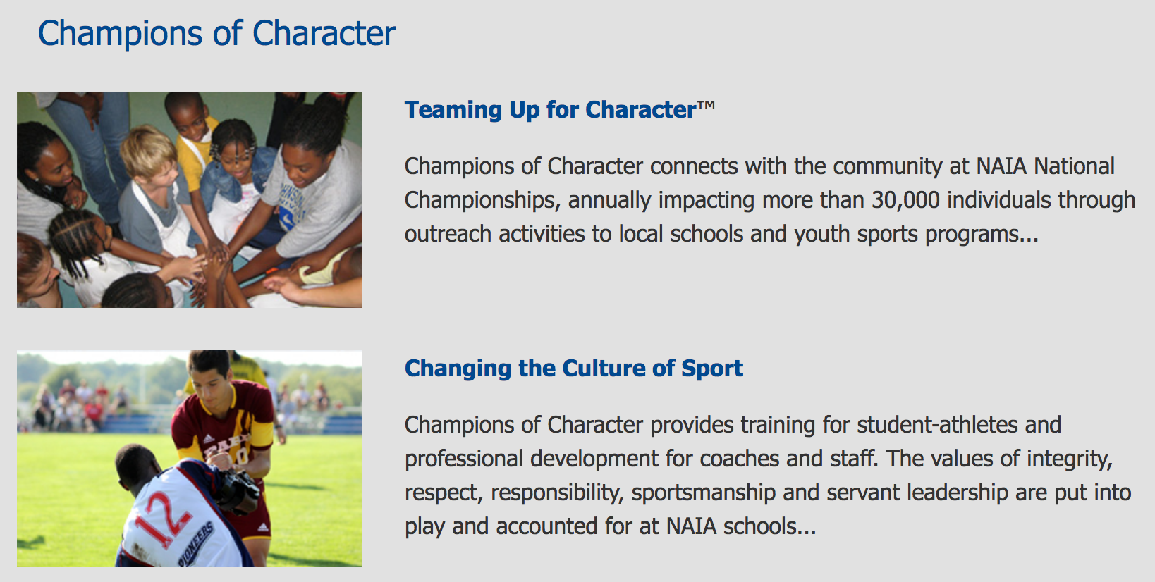
National Association of Intercollegiate Athletics (NAIA)
The purpose of the NAIA Is to promote education and development of students through intercollegiate athletics participation.
NAIA institutions view athletics as “co-curricular” or “part of the educational process,” something that goes hand-in-hand with the pursuit of academic goals.
NAIA believes involvement in athletics will enrich the student-athlete’s college experiences and will balance success in both the classroom and on the field of play.

Slide 6
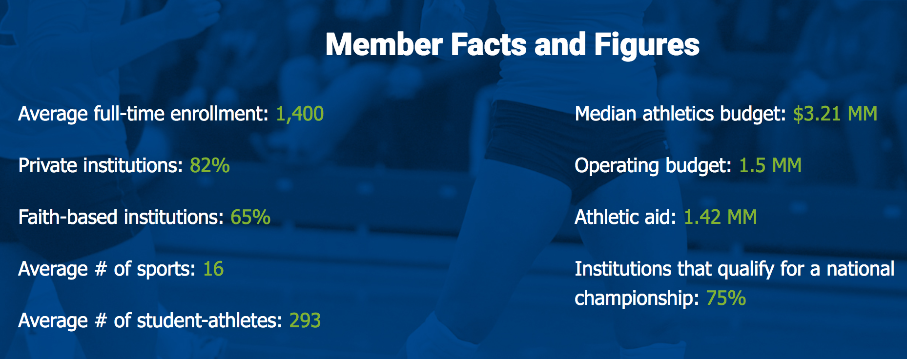
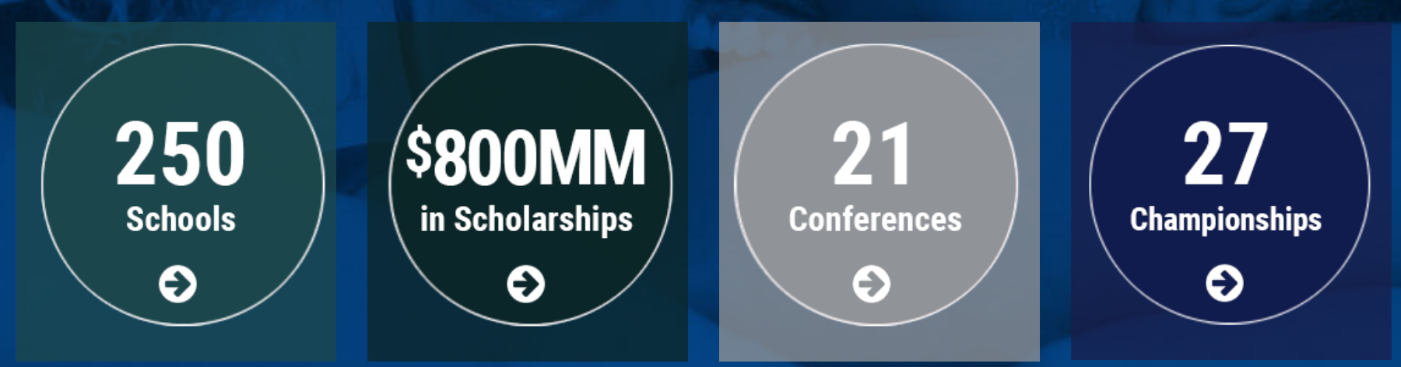
National Association of Intercollegiate Athletics (NAIA)
The NAIA advantage:
High-caliber athletics at a reasonable cost
Institution-level analytics
Athletics-driven enrollment
Autonomy and simple, sensible rules
Superior student-athlete experience

Slide 7
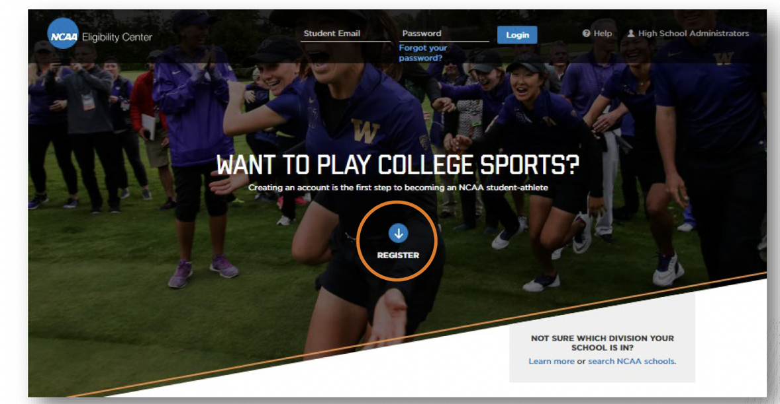
NCAA Eligibility Center

Slide 8
NCAA Eligibility Center: Account Types
Free Profile Account
Certification Account
Used for young recruits and those undecided on division
No registration fee
Ability to transition to a paid certification account later on
Required for DI and DII eligibility certification
Requires a registration fee:
  $90 domestic students
  $150 international students
Required for taking an official visit
Required to sign a NLI
Amateurism Only Account
Used for DIII schools (amateurism only)

Slide 9
NCAA Eligibility Center
When do I register?
  9th grade – register for Free Profile Page
  10th grade – transition to Certification Account
Why do I register?
  Required for taking an official visit
  Coaches can track your progress/ see your grades
  Helps colleges/universities determine your scholarships
  Compliance can track your eligibility progression
  Required to sign a National Letter of Intent

Slide 10
NCAA Eligibility Requirements
DI – Requires the following to receive “academic certification:”
  Complete 16 core courses in proscribed areas
  Complete 10 of 16 core courses, including seven in English, math or natural/physical science, before the start of your seventh semester.
  Earn appropriate SAT/ACT score on sliding scale**See Covid Exception**
  Submit proof of graduation
DII – Requires the following to receive “academic certification:”
  Complete 16 core courses in proscribed areas
  Earn appropriate SAT/ACT score on sliding scale**See Covid Exception**
  Submit proof of graduation
DIII - DIII eligibility is determined on campus.
Link to NCAA Core Courses Lists

Slide 11
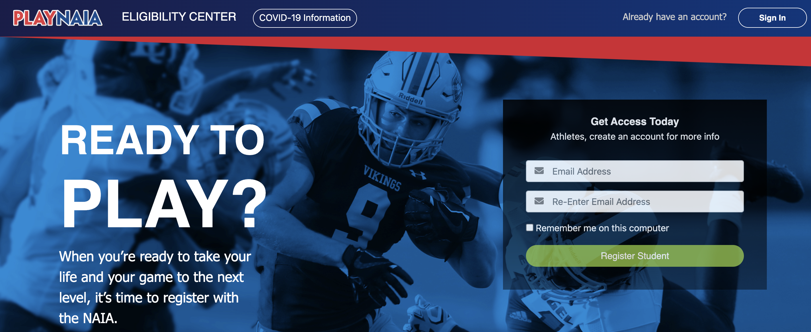
NAIA Eligibility Requirements
If a student meets two of the criteria, then the student is eligible upon high school graduation:
Cumulative GPA of 2.0 on a 4.0 scale
Class rank in top 50% of graduating class
If no class rank is on the transcript, nine college credits can be used in place of this requirement. (Effective May 1, 2020.)
ACT of 18 or SAT of 970 Critical Reading and Math
NAIA Eligibility Center - The fee to register is $90 for students coming directly from high school, $135 for transfer students, and $150 for international students.

Slide 12
NCAA Amateurism Requirements
Must complete the Amateurism questionnaire for EACH sport you plan to compete in and request “Final Amateurism Certification” on April 1 (for Fall enrollees).
Issues Reviewed as Part of the Amateurism Certification Process:
  Delaying your full-time collegiate enrollment to participate in organized competition.
  Playing with professionals.
  Signing a contract with a professional team.
  Participating in tryouts or practices with a professional team.
  Receiving payment or preferential treatment/benefits for playing sports.
  Receiving prize money.
  Receiving benefits from an agent or prospective agent.
  Involvement with a recruiting service.

Slide 13
NAIA Amateurism Requirements
In the NAIA, only amateur students-athletes are eligible to participate in a given sport.
If you become a professional in a particular sport recognized by the NAIA, you will be considered a professional in that sport only and are ineligible for intercollegiate competition in that sport.
The following will cause a student to lose amateur standing:
  Signing a contract with any professional team or entering into an agreement to compete in professional athletics
  Participating in any athletics contest as a professional or as a team member where you receive reimbursement exceeding the actual expenses of travel, meals and lodging
  Receiving remuneration for any appearance or advertisement/promotion that references the student’s collegiate institution or intercollegiate athletic participation.

Slide 14
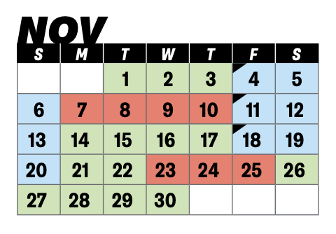

Recruiting 101: Recruiting Calendars
NCAA DI & DII Recruiting Calendars
NCAA DIII – no recruiting calendars
NAIA – no recruiting calendars

Slide 15
Recruiting 101: DI & DII Recruiting Periods Defined
Contact Period: Authorized athletics department staff may make in-person, off-campus recruiting contacts and evaluations.
Evaluation Period: Authorized athletics department staff members may be involved in off-campus activities designed to assess the academic qualifications and playing ability of prospective student-athletes. No in-person, off-campus recruiting contacts shall be made with the prospective student-athlete during an evaluation period.
Quiet Period: A period of time when it is permissible to make in-person recruiting contacts only on the member institution’s campus. No in-person, off-campus recruiting contacts or evaluations may be made during the quiet period.
Dead Period: A period of time when it is not permissible to make in-person recruiting contacts or evaluations on or off the member institution’s campus or to permit official or unofficial visits by prospective student-athletes to the institution’s campus.
Recruiting Shutdown: No form of recruiting is permitted (women’s basketball)

Slide 16
Recruiting 101: NCAA Telephone Calls, Emails, Text Messages (correspondence)
DI – rules vary by sport – most ”start dates” occur between sophomore and junior year
DII – everything is June 15 immediately preceding Junior year
DIII – unlimited with the exception of off-campus contacts which can occur following Sophomore year
*There are exceptions for questionnaires, camp brochures and non-athletics information

Slide 17
NAIA Recruiting
NAIA recruiting rules encourage coach-student and personal relationships. Benefits of NAIA recruiting rules include:
No recruiting calendar restrictions of any kind
Ability to freely communicate with NAIA coaches directly
Direct interaction with NAIA coaches
What does this mean? START EARLY!

Slide 18
Recruiting 101: Campus Visits
Types?
  Official Visits – College can pay for transportation to and from the campus and lodging and meals and reasonable entertainment for a 48 hour period. Basketball also allows for payment for up to two family members on the visit.
  Unofficial Visits – Self funded visits
How Many?
When?
  No visits allows during Recruiting Shutdown and Dead Period
  DI - Official visits begin Junior year (dates vary)
  DII – June 15 prior to junior year
  DIII – January 1 of junior year
DI OV | DII OV | DIII OV | NAIA OV
5 per athlete 1 per institution Certain sports limit per sport *No limit on UV | No limit per athlete 1 per institution *No limit on UV | No limit per athlete 1 per institution *No limit on UV | No limit per athlete 1 per institution *No limit on UV

Slide 19

What is the National Letter of Intent?
The NLI is a voluntary program with regard to both institutions and student-athletes. No prospective student-athlete (PSA) or parent is required to sign the NLI and no institution is required to join the program.
The NLI is a binding agreement between a PSA and an NLI member institution.
The NLI only binds the PSA in attending the institution for the FIRST year of enrollment. SA must receive athletic aid in the SAME year as the NLI. Does not guarantee athletic aid after that…
There are penalties for not fulfilling all of the provisions of the NLI – Check out www.nationalletter.org for more details.

Slide 20
Who issues the NLI?
NCAA DI & DII - An NLI must be accompanied by an athletics aid agreement so only NCAA Division I and II institutions can issue a NLI.
NCAA DIII - Institutions are permitted to use a standard, NCAA provided, non-binding celebratory signing form. A college-bound student-athlete is permitted to sign the celebratory signing form at any point, including high school signing events, after the student-athlete has been accepted to the institution.
NAIA - Prospective students can make written or verbal commitments to attend and participate in athletics at an NAIA member institution. An institution is free to develop and implement its own process for obtaining commitments from a prospective student. These methods can include, but are not limited to, formal financial aid agreements, signed estimated offers of financial aid and athletic letters of intent.

Slide 21
Who Signs the NLI?
Who Can Sign: Prospective student-athletes entering a four-year institution for the first time as full time students.
  High school Seniors
  Junior college transfers
*If a PSA reclassifies her graduation year (e.g., junior to senior), the PSA can sign during the NLI signing period prior to the upcoming fall enrollment.
Requirements to Sign:
  Register with NCAA Eligibility Center
  Complete the amateurism certification questionnaire administered by the NCAA Eligibility Center (DI)
  Submit transcript to institution (DII)

Slide 22
NAIA Athletic Scholarships
Each school determines how much aid it awards to an individual student-athlete. Under no conditions may anyone else provide direct financial assistance to any student-athlete.
Financial aid to student-athletes is limited to the actual cost of:
  Tuition
  Mandatory fees, books, and supplies are required for courses in which the student-athlete is enrolled
  Room and board based on the official room and board allowance listed in the institution’s catalog
Each sport has an overall limit on the amount of financial aid it can award as full or partial grants to students in that sport. Included on page 2 of NAIA Guide for the College Bound Student Athlete

Slide 23
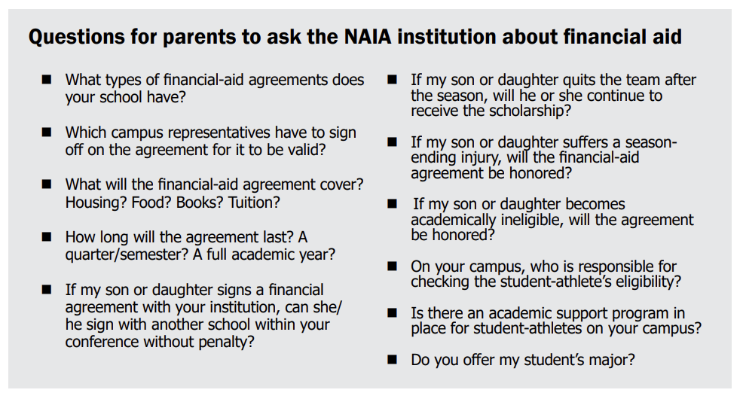
NAIA Athletic Scholarships

Slide 24
NCAA Athletic Scholarships
DI Athletic Scholarships | DII Athletic Scholarships
Can award up to cost-of-attendance (as determined by the individual college) | Can cover tuition and fees, room and board, and course related books/supplies
May award multi-year scholarships | May provide a one-year scholarship
May pay for degree completion | May pay for degree completion
Must notify SAs if athletic aid is not renewed (July 1) | Must notify SAs if athletic aid is not renewed (July 1)
Award to head count sports & equivalency sports | All sports are equivalency sports
Teams have a maximum to award each year | Teams have a maximum to award each year
DIII/ Ivy League – Do not issue athletic scholarships but most SAs are some sort of non-athletic aid
NAIA – All sports are equivalency sports

Slide 25
Head Count vs Equivalency Sports
Head Count Sport – all athletes receiving an athletic scholarship are receiving a “full grant-in—aid” or “cost-of-attendance” scholarship
Indoor volleyball, basketball, tennis, gymnastics
Equivalency Sport – athletes receiving an athletic scholarship may receive any amount of athletic aid up to cost-of-attendance
Bowling, lacrosse, rowing, cross-country, track and field, skiing, fencing, soccer, field hockey, softball, golf, swimming, ice hockey, beach volleyball and water polo
**Not all schools fund each sport up to the maximum**

Slide 26
Athletic Scholarships & the NLI
NCAA DI – permitted to award multi-year athletic scholarships, however, to sign a NLI, there must be athletic aid awarded in the same year as the NLI.
Correct:
2022-23: $10,000
2023-24: $10,000
2024-25: $0
2025-26: $0
Incorrect:
2022-23: $0
2023-24: $0
2024-25: $10,000
2025-26: $10,000

Slide 27
Resources
Carondelet Athletics Website – College Recruitment Resources
NCAA Eligibility Center – www.eligibilitycenter.org
NAIA Eligibility Center – www.playNAIA.org
NCAA Guide for the College Bound Student-Athlete
NAIA Guide for the College Bound Student-Athlete
Quick Reference Guide to the NLI

Slide 28
Key Takeaways!
Students should focus on a college/university as a whole when planning their future but if they are interested in competing in sports at the next level, do research on whether the institution is NAIA or NCAA and what division. Also research the teams available at each institution – club teams do not need to follow these same rules. Start Early!
Register with the appropriate eligibility centers, submit transcripts and test scores (if applicable). College & Career can help with this!
Reach out to college coaches – we will discuss this further at the October 14th workshop for students!
Take unofficial visits!
Become knowledgeable on admissions requirements – College & Career can help with this!
Research alternative financial aid options – are you able to start as a “walk on” athlete?
Ask questions regarding Financial Aid – this is usually a topic where college coaches will speak directly with parents/guardians

Slide 29
October 14th Workshop
Advised for Sophomores & Juniors looking for more assistance in navigating the college athletics recruitment process.
No need for students to register – location is tba
We will cover:
  More detailed recruiting rules
  Prepping for campus visits
  Creating an Athletic Resume
  How to reach out to college coaches
  Tryouts
  Alternative recruiting methods

